Slide 1
Update: Piezo-energy harvesting
Chongan Wang
2025-02-14

Slide 2
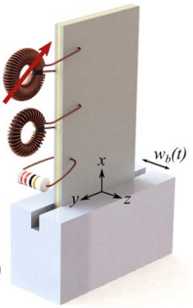
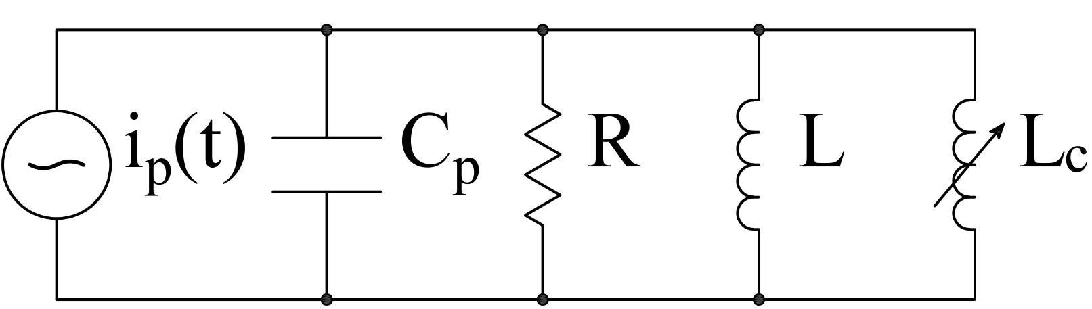






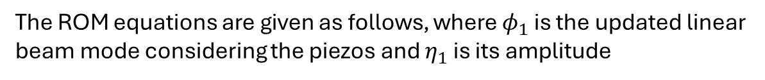

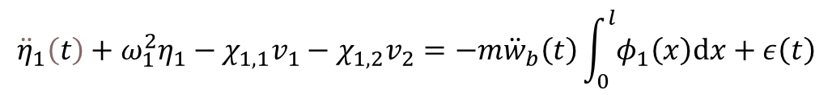

Analytical Foundation – a Review
The current structural damping of the beam is 0
The ROM equations are given as follows, where $φ_{1}$ is the updated linear beam mode considering the piezos and $η_{1}$ is its amplitude
$$x=l$$
$$v\left(t\right)$$
$${\ddot{η}}_{1}\left(t\right)+ω_{1}^{2}η_{1}−χ_{1,1}v_{1}−χ_{1,2}v_{2}=−m{\ddot{w}}_{b}\left(t\right)\int_{0}^{l}{φ_{1}\left(x\right)dx}+ε\left(t\right)$$
Beam:
$$C_{p}\frac{dv_{1}\left(t\right)}{dt}+\frac{v_{1}\left(t\right)}{R_{1}}+κ_{1,1}\frac{dη_{1}}{dt}=0$$
$$x=\frac{l}{2}$$
Harvester:
$$C_{p}\frac{dv_{2}\left(t\right)}{dt}+θ\int_{0}^{l}{\frac{∂^{3}w}{∂x^{2}∂t}dx}=i_{2}\left(t\right)$$
Modulator:
Harvesting power: $P_{1}=v_{1}^{2}/R_{1}$
Modulating power: $P_{2}=v_{2}i_{2}$
We note that $v_{2}$ and $w_{b}$ are prescribed

Slide 3
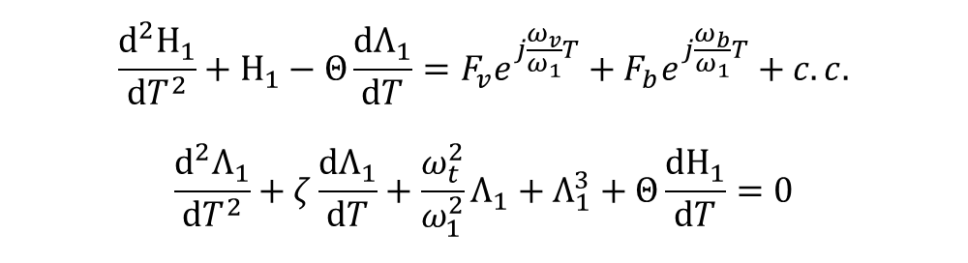
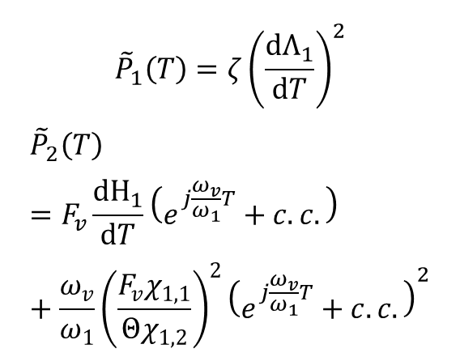
Normalized System
$$\frac{d^{2}Η_{1}}{dT^{2}}+Η_{1}−Θ\frac{dΛ_{1}}{dT}=F_{v}e^{j\frac{ω_{v}}{ω_{1}}T}+F_{b}e^{j\frac{ω_{b}}{ω_{1}}T}+c.c.$$
$$\frac{d^{2}Λ_{1}}{dT^{2}}+ζ\frac{dΛ_{1}}{dT}+\frac{ω_{t}^{2}}{ω_{1}^{2}}Λ_{1}+Λ_{1}^{3}+Θ\frac{dΗ_{1}}{dT}=0$$
Results without perturbation
We evaluate the total energy at the normalized time 10000
$${\tilde{P}}_{1}\left(T\right)=ζ{\left(\frac{dΛ_{1}}{dT}\right)}^{2}$$
$${\tilde{P}}_{2}\left(T\right)=F_{v}\frac{dΗ_{1}}{dT}\left(e^{j\frac{ω_{v}}{ω_{1}}T}+c.c.\right)+\frac{ω_{v}}{ω_{1}}{\left(\frac{F_{v}χ_{1,1}}{Θχ_{1,2}}\right)}^{2}{\left(e^{j\frac{ω_{v}}{ω_{1}}T}+c.c.\right)}^{2}$$

Slide 4
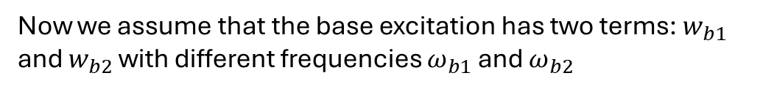
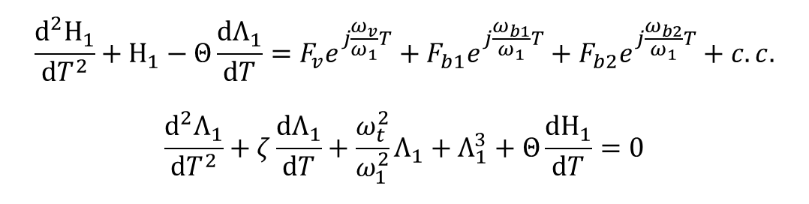
Robustness to Second Harmonics
The current structural damping of the beam is 0
$$x=l$$
$$\frac{d^{2}Η_{1}}{dT^{2}}+Η_{1}−Θ\frac{dΛ_{1}}{dT}=F_{v}e^{j\frac{ω_{v}}{ω_{1}}T}+F_{b1}e^{j\frac{ω_{b1}}{ω_{1}}T}+F_{b2}e^{j\frac{ω_{b2}}{ω_{1}}T}+c.c.$$
$$\frac{d^{2}Λ_{1}}{dT^{2}}+ζ\frac{dΛ_{1}}{dT}+\frac{ω_{t}^{2}}{ω_{1}^{2}}Λ_{1}+Λ_{1}^{3}+Θ\frac{dΗ_{1}}{dT}=0$$
$$v\left(t\right)$$
$$x=\frac{l}{2}$$
Now we assume that the base excitation has two terms: $w_{b1}$ and $w_{b2}$ with different frequencies $ω_{b1}$ and $ω_{b2}$
The normalized amplitude of the secondary harmonics is $F_{b2}$
Assuming minor perturbation, the velocity amplitude of the secondary harmonics is 10% of the major harmonics

Slide 5
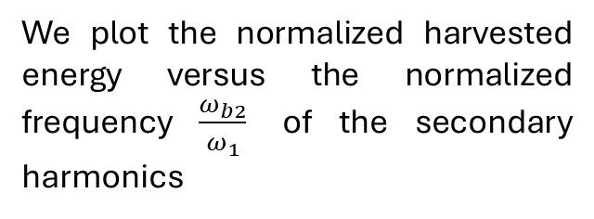
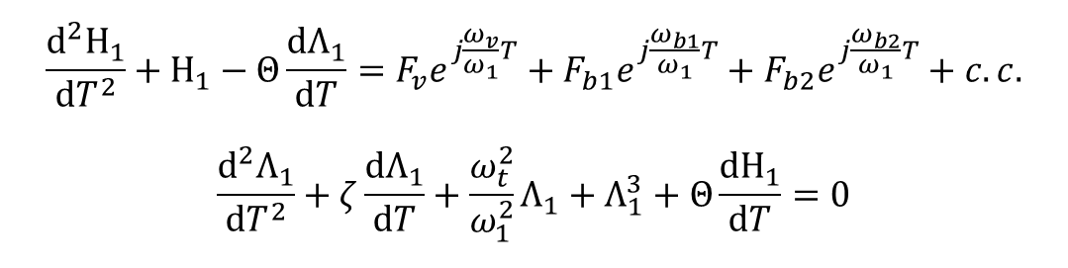
The flux linkage response to base excitation
$$\frac{d^{2}Η_{1}}{dT^{2}}+Η_{1}−Θ\frac{dΛ_{1}}{dT}=F_{v}e^{j\frac{ω_{v}}{ω_{1}}T}+F_{b1}e^{j\frac{ω_{b1}}{ω_{1}}T}+F_{b2}e^{j\frac{ω_{b2}}{ω_{1}}T}+c.c.$$
$$\frac{d^{2}Λ_{1}}{dT^{2}}+ζ\frac{dΛ_{1}}{dT}+\frac{ω_{t}^{2}}{ω_{1}^{2}}Λ_{1}+Λ_{1}^{3}+Θ\frac{dΗ_{1}}{dT}=0$$
We plot the normalized harvested energy versus the normalized frequency $\frac{ω_{b2}}{ω_{1}}$ of the secondary harmonics
In all frequencies of secondary harmonics, the higher-branch is excited and the nonlinear system significantly outperform the linear system

Slide 6


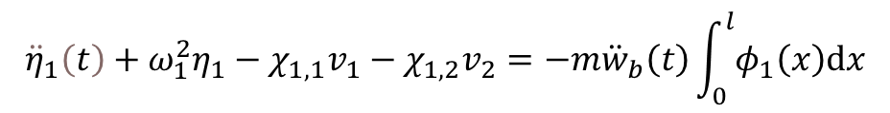

Brownian Motion
The reduced order model requires that $w_{b}$ is twice differentiable:
$${\ddot{η}}_{1}\left(t\right)+ω_{1}^{2}η_{1}−χ_{1,1}v_{1}−χ_{1,2}v_{2}=−m{\ddot{w}}_{b}\left(t\right)\int_{0}^{l}{φ_{1}\left(x\right)dx}$$
Beam:
$$C_{p}\frac{dv_{1}\left(t\right)}{dt}+\frac{v_{1}\left(t\right)}{R_{1}}+κ_{1,1}\frac{dη_{1}}{dt}=0$$
Harvester:
$$C_{p}\frac{dv_{2}\left(t\right)}{dt}+θ\int_{0}^{l}{\frac{∂^{3}w}{∂x^{2}∂t}dx}=i_{2}\left(t\right)$$
Modulator:
FEM model:
$$\left[M\right]\ddot{x}+\left[C\right]\dot{x}+\left[K\right]x+f_{nl}\left(x\right)=F\left(t\right)$$
Prescribed boundary condition means that an element of $x$ is prescribed
Since $\left[M\right]$ is not diagonal, the acceleration of the boundary is still needed for the entire simulation.

